Slide 1
MICROSOFT CERTIFIED: AZURE ADMINISTRATOR ASSOCIATE(AZ-104)

Slide 2
Azure Cosmos DB Consistency Level Selection Study
TEAM MEMBERS:
Lella Rohitha - 2400030280
Namburi Reethika - 2400030265
Vuyyuru Tejesh - 2400030254
Bhavanam Joshika - 2400030221
.

Slide 3
index
**S.No.** **Content** **Page No.**
1. Project Objective 4
2. Services Used 5
3. Step-by-Step Process 6–14
4. Use Cases 15
5. Azure Advisor Result 16
6. Challenges / Bottlenecks 17
7. Conclusion 18

Slide 4
1. Project Objective
Azure Cosmos DB Consistency Level Selection Study aims to:
Select suitable consistency levels for three different access patterns.
Compare latency, cost, and data correctness.
Understand the effect of stronger and weaker consistency on application performance.
Choose a cost-effective consistency level for each use case.

Slide 5
2. Services Used
-Azure Cosmos DB :- Main NoSQL database for storing and accessing data.
-Azure Portal :- Used to create, configure, and monitor the Cosmos DB account.
-Azure Cosmos DB Consistency Levels :- Strong, Bounded Staleness, Session, Consistent Prefix, and Eventual.
-Request Units (RU/s) :- Used to measure and provision database throughput and estimate cost

Slide 6
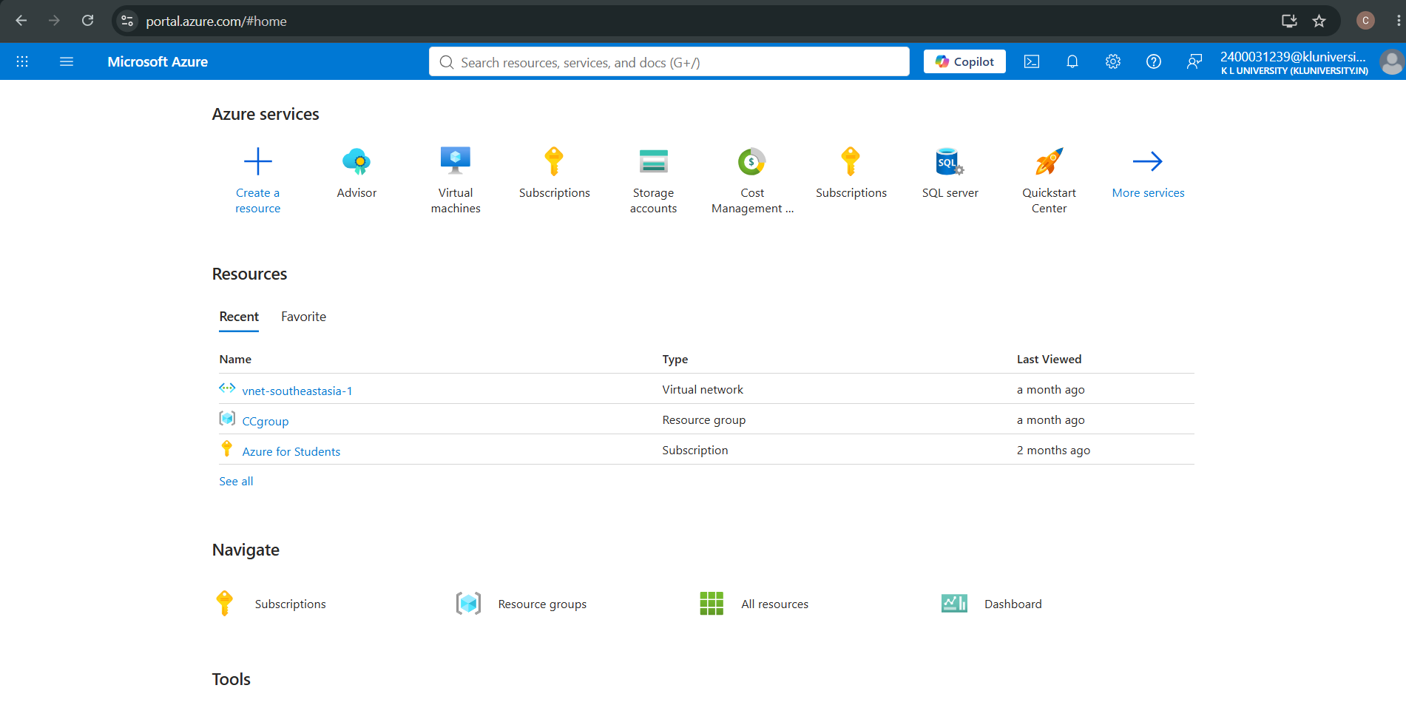
3. Step-by-Step Execution
Step 1 — Open Azure Portal
sign in to Azure Portal and verify the Azure for Students subscription.

Slide 7
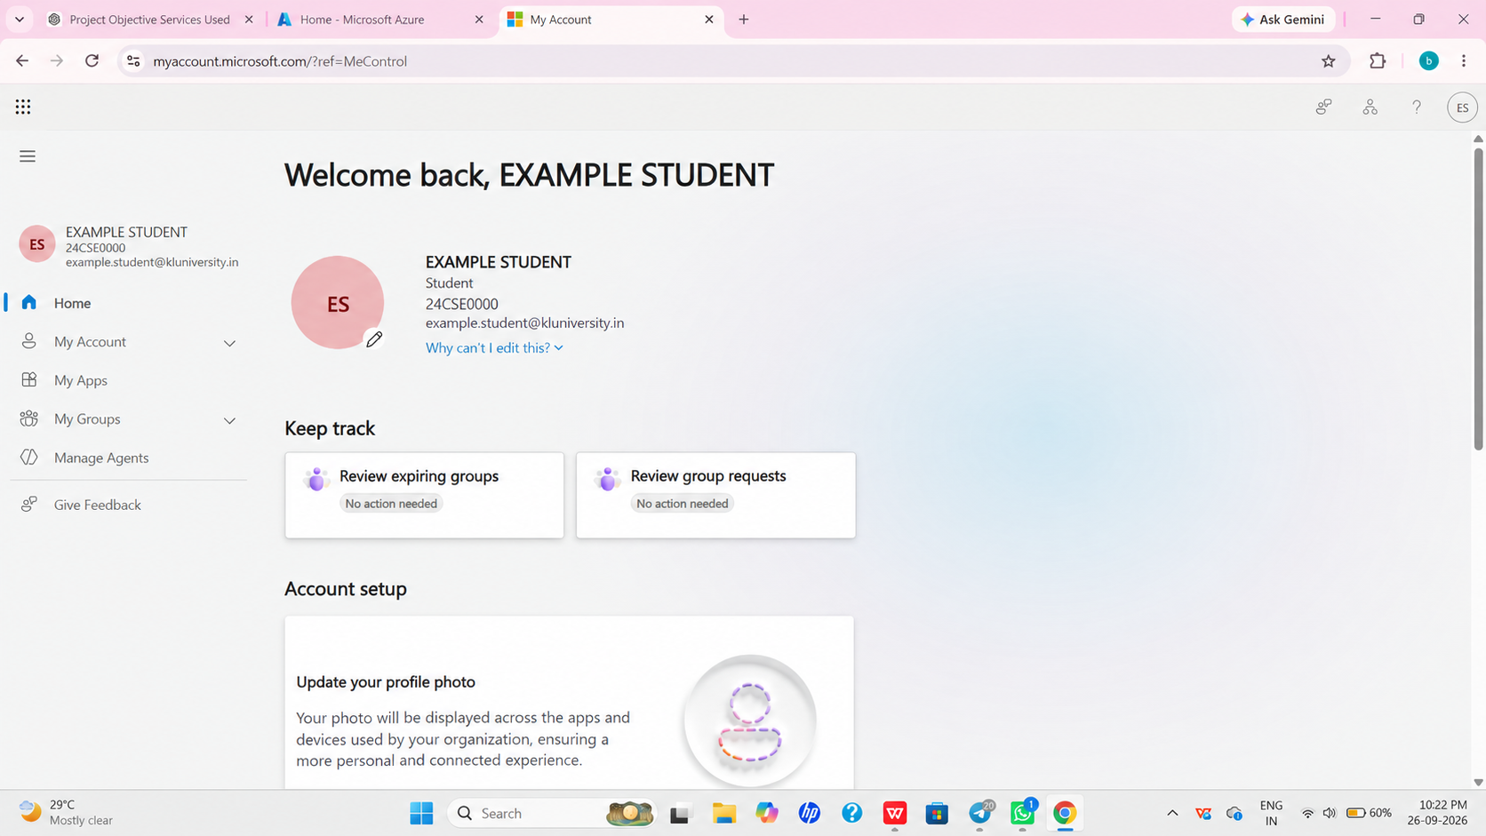
Step 2 — Ensure succesful login
Make sure that login is successful with correct information and credentials.

Slide 8
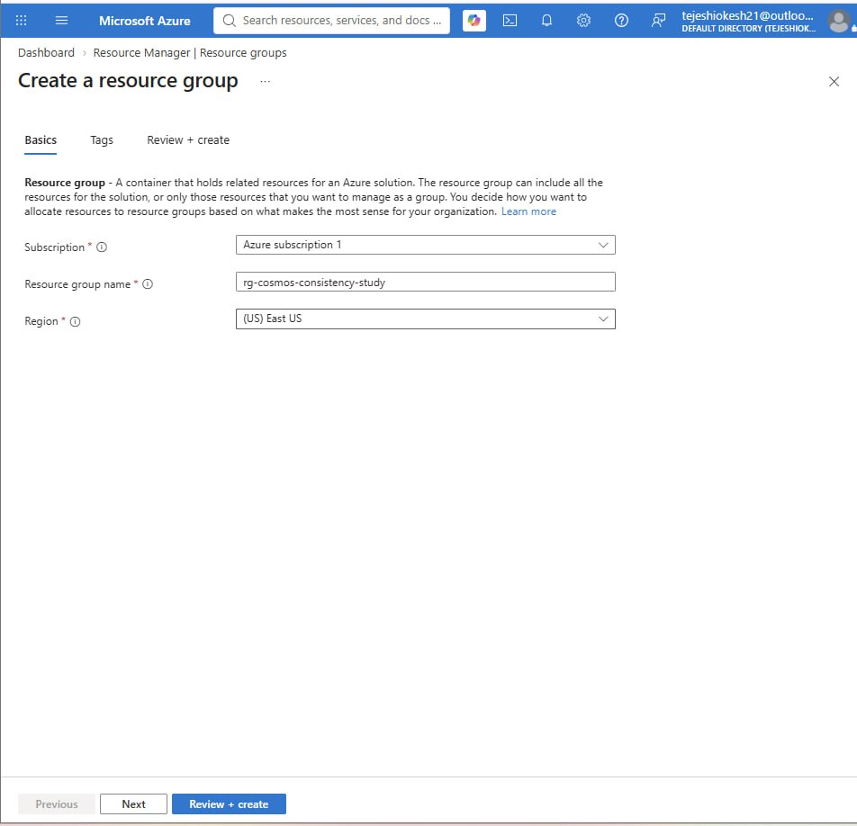
Step 3 — Create the resource group
Create a resource group named rg-cosmos-consistency-study in the selected Azure region to organize and manage all resources related to the Cosmos DB project.

Slide 9
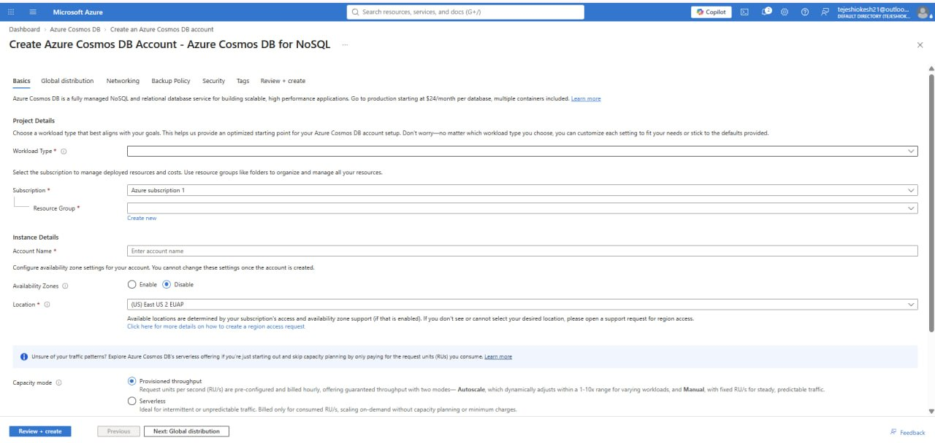
Step 4 - create the azure cosmos db for no sql
Set up an Azure Cosmos DB for NoSQL account to store and manage the project data.

Slide 10
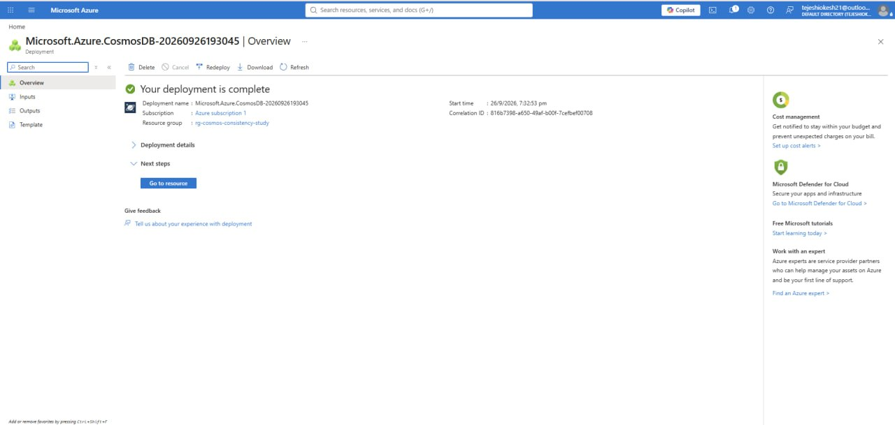
Step 5 - succesful creation of cosmos db
Azure Cosmos DB for NoSQL was successfully created and is ready to store and manage project data.

Slide 11
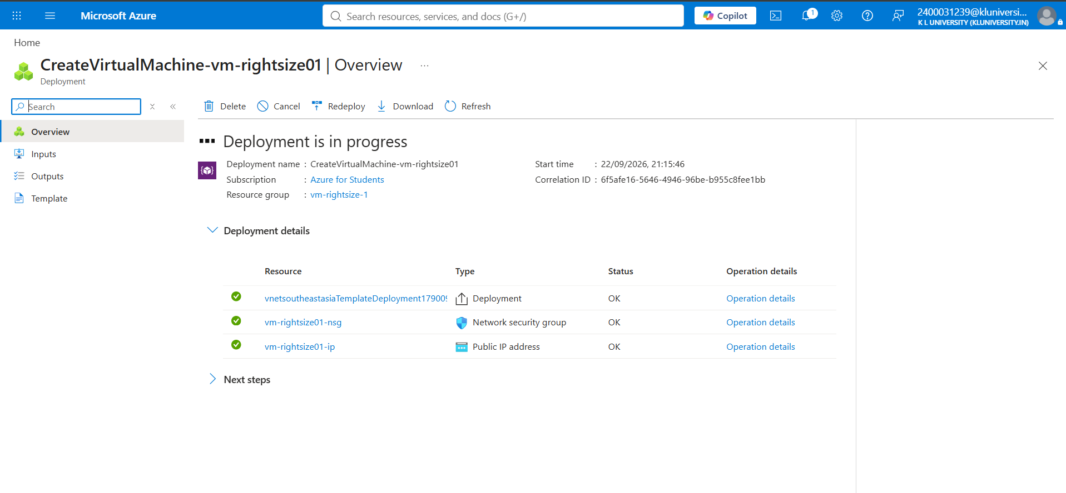
Step 6— creation of containers using of resource groups by data explorer
Using Data Explorer, create a database and containers within the Cosmos DB resource group to organize and store project data efficiently.

Slide 12
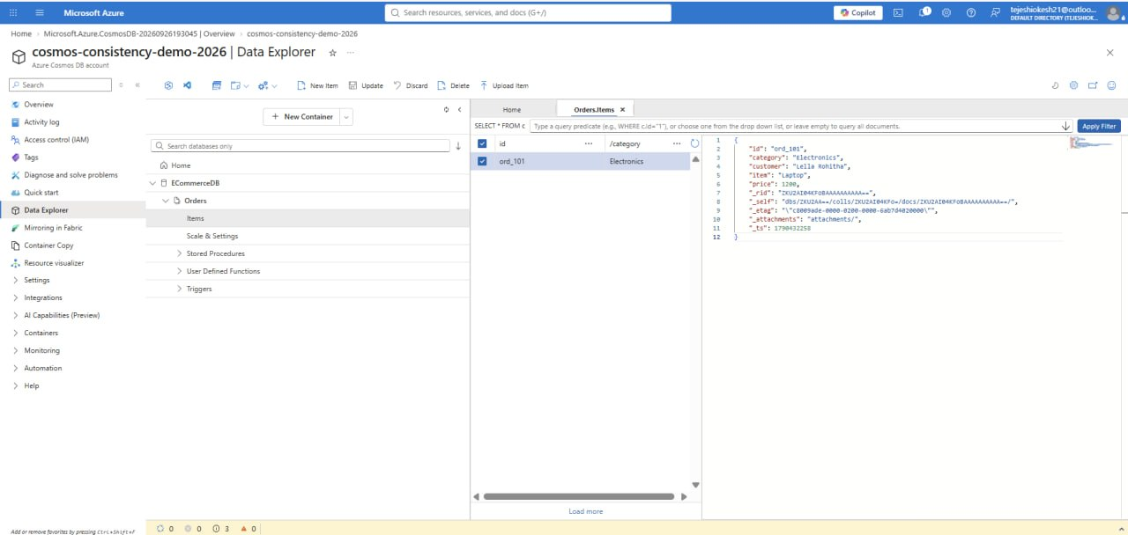
Step 7 — creating of applications is Ecommernece related information in it
Create an e-commerce application containing product, customer, order, and payment-related information in Azure Cosmos DB

Slide 13
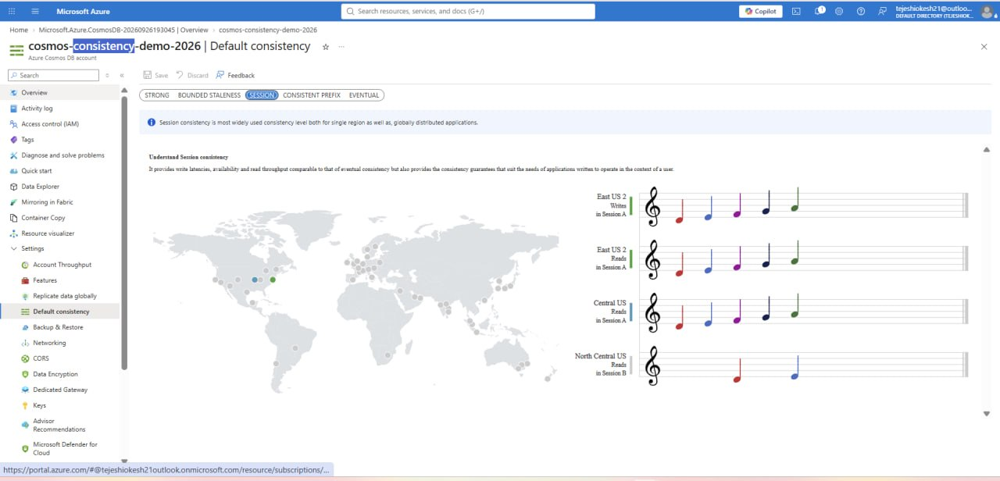
Step 8— observing the different consistence levels in cosmos db
Observe and compare the different consistency levels in Azure Cosmos DB to understand their impact on data accuracy, latency, and performance.

Slide 14
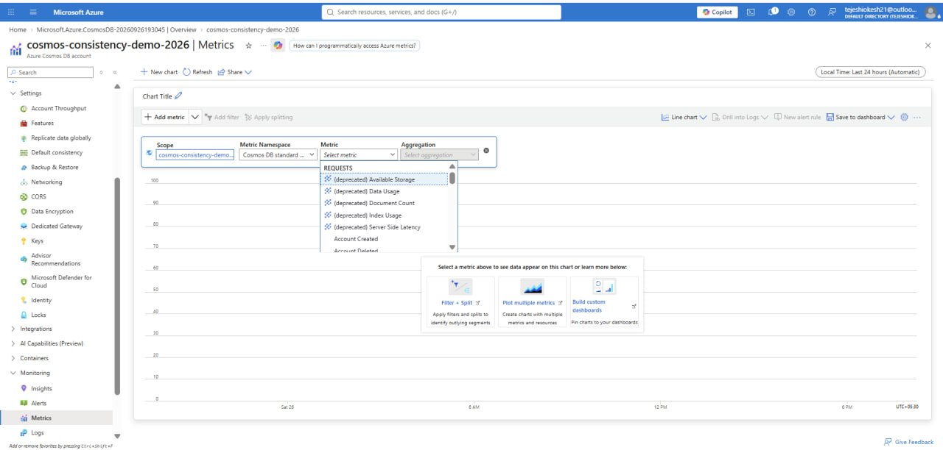
Step 9—observing the metrices will created on application of ecommerence
Observe the metrics generated by the e-commerce application to analyze its performance.

Slide 15
4. usecases
E-commerce: Manage product, customer, order, and payment data.
Online Gaming: Store player profiles, scores, and game sessions.
IoT Applications: Store and process data from connected devices.
Social Media: Manage user profiles, posts, likes, and comments.
Real-Time Analytics: Analyze large volumes of data with low latency.

Slide 16
5. Azure Advisor Result
Azure Advisor analyzed the Azure resources and provided recommendations to improve performance, reduce costs, increase reliability, strengthen security, and optimize resource usage.

Slide 17
6. Challenges / Bottlenecks
Choosing the right consistency level for different applications.
Balancing data consistency and response latency.
Higher consistency levels may require more resources and cost.
Monitoring and understanding Cosmos DB metrics can be challenging.
Managing large amounts of e-commerce data efficiently.
Maintaining fast performance during high user traffic.

Slide 18
7. Conclusion
The project successfully demonstrated the creation and configuration of Azure Cosmos DB for NoSQL for an e-commerce application. Different consistency levels and performance metrics were observed to understand their impact on data consistency, latency, performance, and cost.

Slide 19
THANK YOU

